Slide 1

SNAKE AND LADDER GAME
By:- Ibrahim, Rahul, Nitin
Sprint: Programming the Web

Slide 2
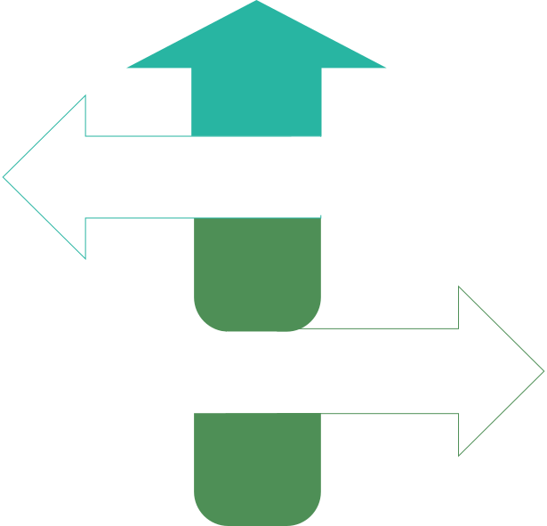
PROJECT SCOPE
Team
APIs Used
3–4 members collaborating on design, coding, and analysis
Shared roles:
Ibrhaim : Would be part of everything
Rahul : Would be part of everything
Nitin : Would be part of everything
APIs: random.org (generates fair dice rolls) and Open Trivia DB (provides quiz questions).
Enhancement: They enhance interactivity by replacing a simple click with a true random roll and adding a skill-based trivia challenge to the core snake/ladder mechanic.
Project Expectations
Goals
Deliverables
✓ Build an interactive webpage using one/two public APIs
✓ Implement DOM manipulation and event listeners
✓ Analyze browser–server communication using Wireshark
✓ Hosted webpage link
✓ Source code (index.html, style.css, script.js)
✓ Wireshark captures + 2–3 page analysis report
Project Deliverables
Tools & Technologies
Constraints
HTML, CSS, JavaScript (Fetch API, Async/Await)
Wireshark for network packets tracing
GitHub Pages / Netlify / Vercel for deployment
Use only open/free APIs
Page must show clear DOM updates & interactivity
Hosted version must load without any dependencies

Slide 3
PROJECT SCOPE & DELIVERABLES
Phase
Scope
(What you will do)
Deliverables
(What you will produce)
Phase 1: Design & Setup
We use the Open Trivia DB API to generate quizzes, requiring correct answers to climb ladders or avoid snakes.
Random.org for random dice roll
This webpage will host an interactive 2-player Snakes and Ladders game where trivia questions from an API determine if you climb ladders or slide down snakes.
APIs: We'll use Open Trivia DB's /api.php to fetch quiz questions and random.org's generateIntegers endpoint for a 1-6 dice roll.
Wireframe: The design is a single-screen app featuring the main game board, a side panel for dice/turn info, and a pop-up modal for trivia.
Folder Setup: A simple structure: a main project folder containing index.html, style.css, and script.js.
Phase 2: Development & Integration
You'd use fetch() to make the request, .then() to parse the response as JSON, and another .then() to update the DOM (like setting innerHTML) with the data.
The player piece positions, the dice display, the trivia modal (with question/answers), and the current turn/game status indicator.
Describe any event listeners or interactivity planned
Working prototype showing API data updates
Code files (index.html, style.css, script.js)
Screenshots of web page functionality
Phase 3: Testing, Analysis & Hosting
I'll capture packets in Wireshark by applying a display filter for the APIs' hostnames (e.g., http.host contains "random.org").
I will observe the GET request methods, 200 OK status codes, round-trip latency, and the JSON response payloads.
I'll use a static hosting platform like GitHub Pages or Netlify for deployment.
Wireshark capture (.pcapng or screenshots)
Hosted webpage link
2–3 page report with screenshots and findings

Slide 4
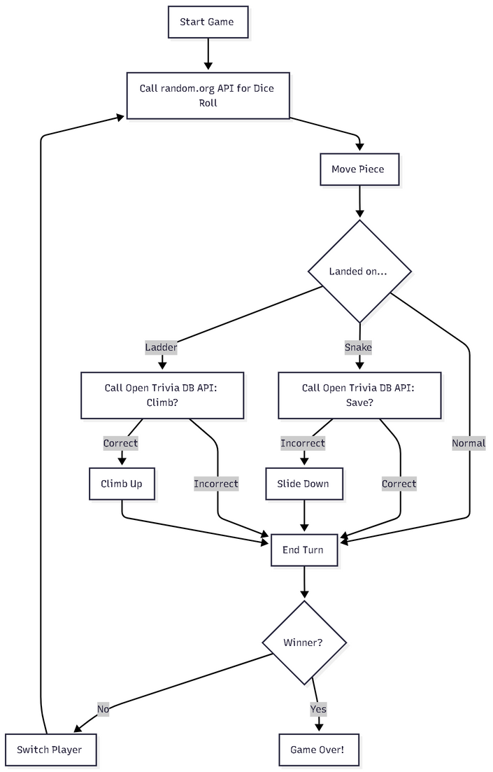

Slide 5

LINK

